Slide 1

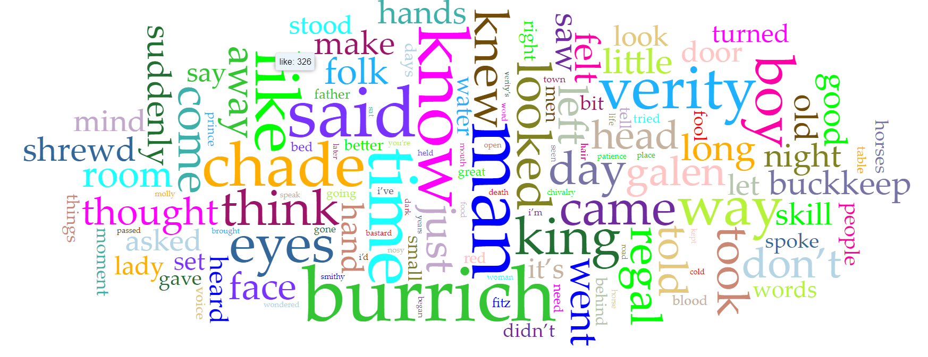
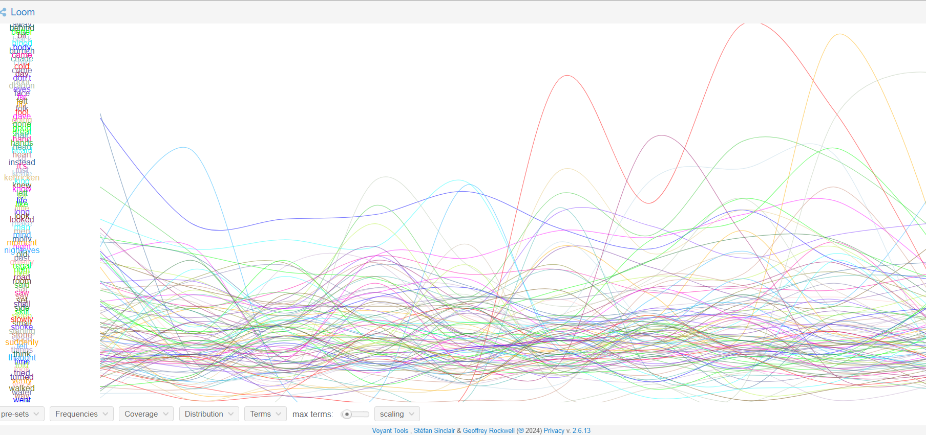
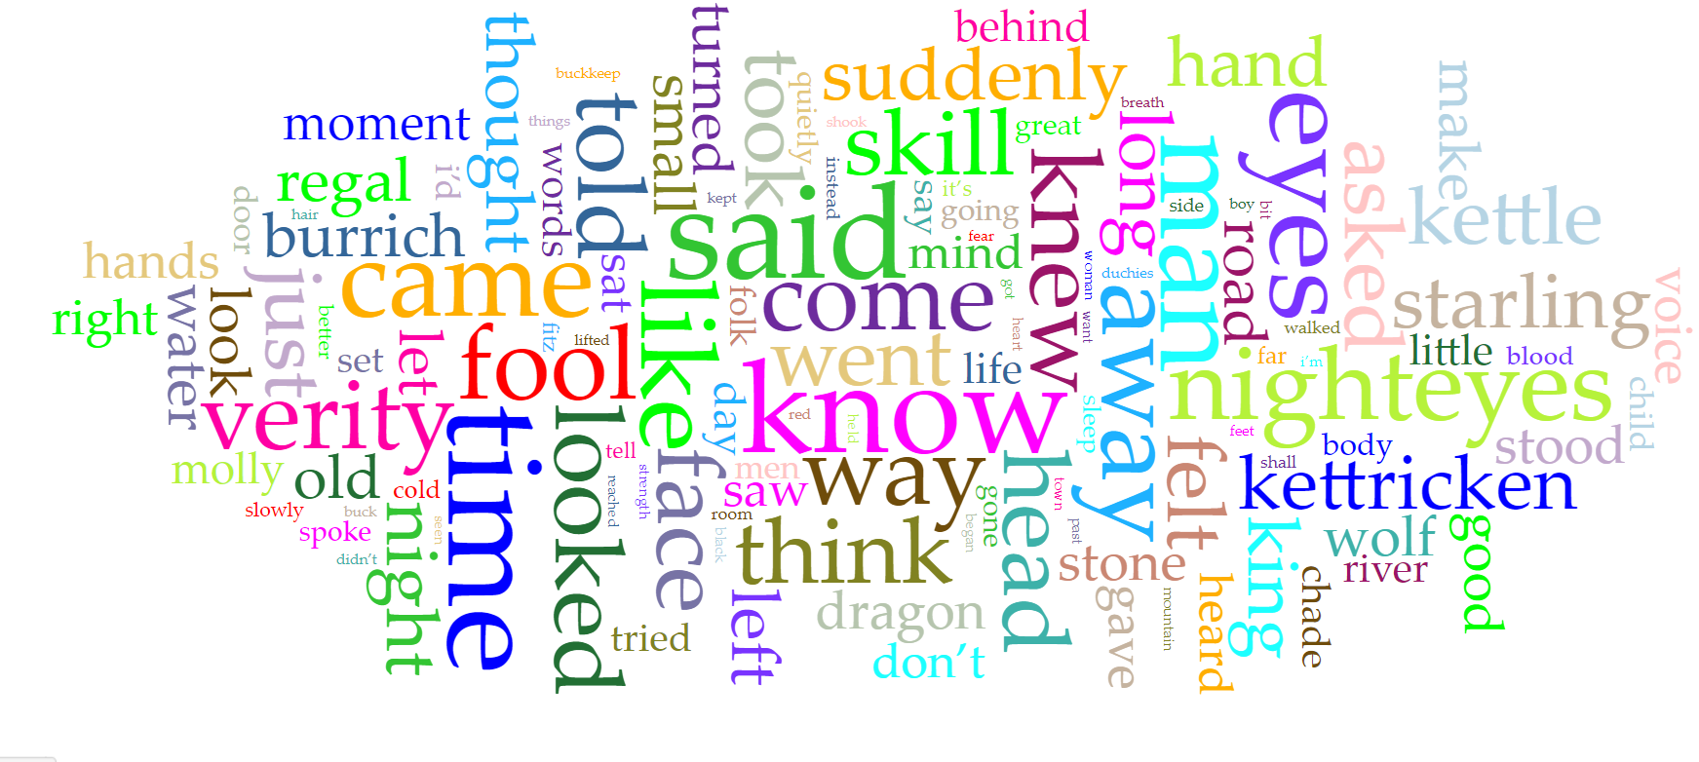
Working with Corpus
The project involves a detailed analysis of the Farseer Trilogy by Robin Hobb, focusing on character interactions, thematic elements, and word usage across the three books. Using computational tools available on voyant tools
Findings
word clouds to highlight frequently used words, and interactive graphs to track word frequency over time
allowed for a detailed examination of thematic elements, character development, and the narrative structure within the series
Ahsen Saaim
Spring 2024
Introduction to Digital Humanities

